Slide 1
Classification of Road Accident Severity
Notes:
此範本可當作起始檔案，以便提供專案的更新 里程碑的更新。
章節
在投影片上按一下右鍵以新增章節。 章節可協助您組織投影片，或簡化多個作者之間的共同作業。
備忘稿
使用 [備忘稿] 章節記錄交付備忘稿，或提供其他詳細資料給對象。 於簡報期間在 [簡報檢視] 中檢視這些備忘稿。
請記住字型大小 (對於協助工具、可見度、影片拍攝及線上生產非常重要)
協調的色彩
請特別注意圖形、圖表及文字方塊。
考慮出席者將以黑白或 灰階列印。執行測試列印，以確保在進行純黑白及 灰階列印時色彩正確。
圖形、表格和圖表
保持簡單: 如果可能，使用一致而不令人分心的樣式和色彩。
所有圖表和表格都加上標籤。

Slide 2
Value of Classification of Road Accident Severity
Road accident can occur anytime and anywhere and it may cause heavy casualties. It is good for public to understand the potential risk factors of road traffic factors
Transportation bureau can take necessary precautions to minimize the occurrence of road accidents
Maths , Statistic major students and data scientist would also be interested in the development of classification model
Notes:
專案內容 為何?
定義 此專案的目標
它類似於過去專案或是新工作?
定義此專案的範圍
它是一個獨立的專案，或與其他專案相關?
* 注意，每週狀態會議不一定需要這張投影片

Slide 3
Data Handling
The data is source by public transportation data for Seattle city
Total 194,673 records, 581,188 SEVERITYCODE=1 records and the rest are SEVERITYCODER=2
38 data columns, after data cleansing, 3 columns would be used in model development.
Notes:
* 如果任何 這些問題造成排程延遲或需要進一步討論，請將細節放入下一張投影片。

Slide 4
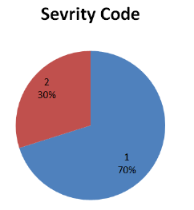
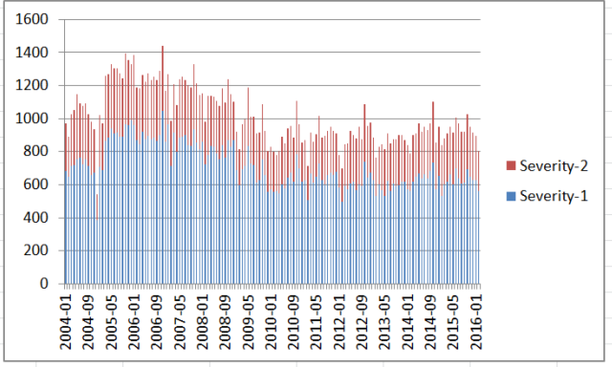
70% road accidents were classified as Severity 1

Slide 5
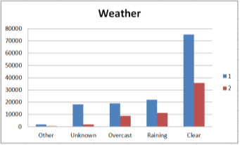
Distribution of the features against accident severity
Weather
Severity 1 happened most even it is clear weather
Notes:
如有一個以上的問題，請依需要複製此投影片。
本投影片和相關投影片 必要時可以移到附錄或隱藏。

Slide 6
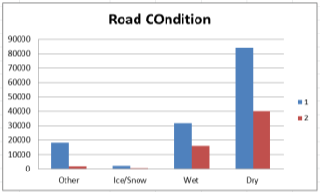
Distribution of the features against accident severity
Road Condition
Severity 1 happened most even the road is dry
Notes:
如有一個以上的問題，請依需要複製此投影片。
本投影片和相關投影片 必要時可以移到附錄或隱藏。

Slide 7
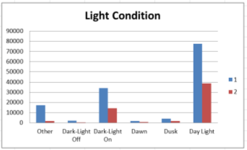
Distribution of the features against accident severity
Road Condition
Severity 1 happened most even there is day light
Notes:
如有一個以上的問題，請依需要複製此投影片。
本投影片和相關投影片 必要時可以移到附錄或隱藏。

Slide 8
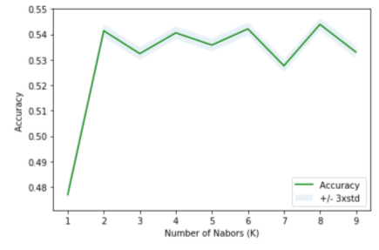
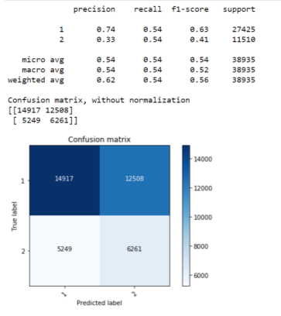
Model performance
Model accuracy reached the highest if number of K =8

Slide 9
Conclusion and future directions
Closely monitor the model performance
Capture more diversified data features such as status during driving, model of the cars
Engage more data scientists and transportation bureau officers in
model development to share experience

